Slide 1

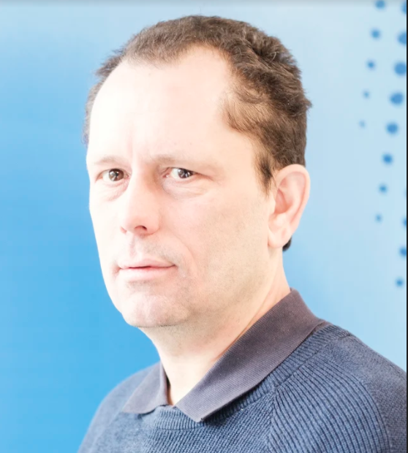
SIGCOMM’20 Tutorial Multipath Transport Protocols
Presenters
Olivier Bonaventure, UCLouvain
Quentin De Coninck, UCLouvain
Schedule
10:00-11:00 EDT Multipath TCP, Olivier
11:00-11:30 EDT Hands-on, Quentin
12:00-13:00 EDT Multipath QUIC, Quentin
13:00-13:30 EDT Hands-on, Quentin
Please download and install our VM
https://github.com/qdeconinck/sigcomm20_mptp_tutorial
And use slack channel for questions

Slide 2




Multipath TCP
The VM prepared by Quentin De Coninck for the hands-on is available from https://github.com/qdeconinck/sigcomm20_mptp_tutorial
Olivier Bonaventure
https://inl.info.ucl.ac.be
https://perso.uclouvain.be/olivier.bonaventure
Thanks to Sébastien Barré, Christoph Paasch, Grégory Detal, Mark Handley, Costin Raiciu, Alan Ford, Micchio Honda, Fabien Duchene, Quentin De Coninck, Benjamin Hesmans, Viet-Hoang Tran and many others
SIGCOMM’20 Tutorial

Slide 3
Agenda
Why Multipath TCP ?
Barriers to Multipath TCP
A closer look at the Multipath TCP protocol

Slide 4
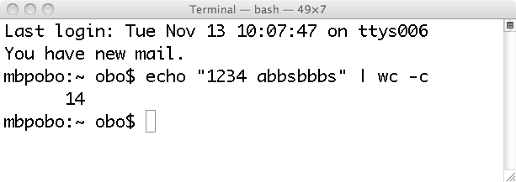
The Unix pipe model
1234 abbsbbbs
echo
wc

Slide 5
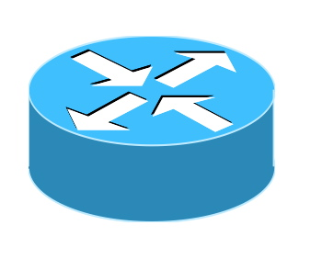
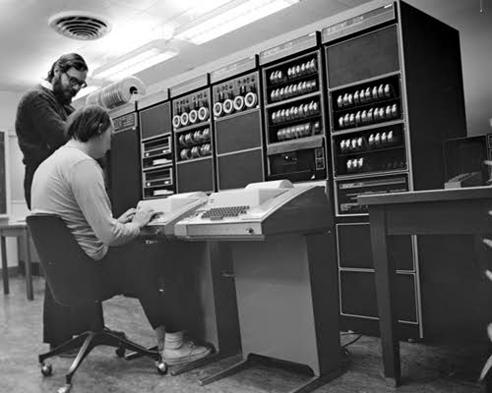
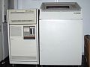
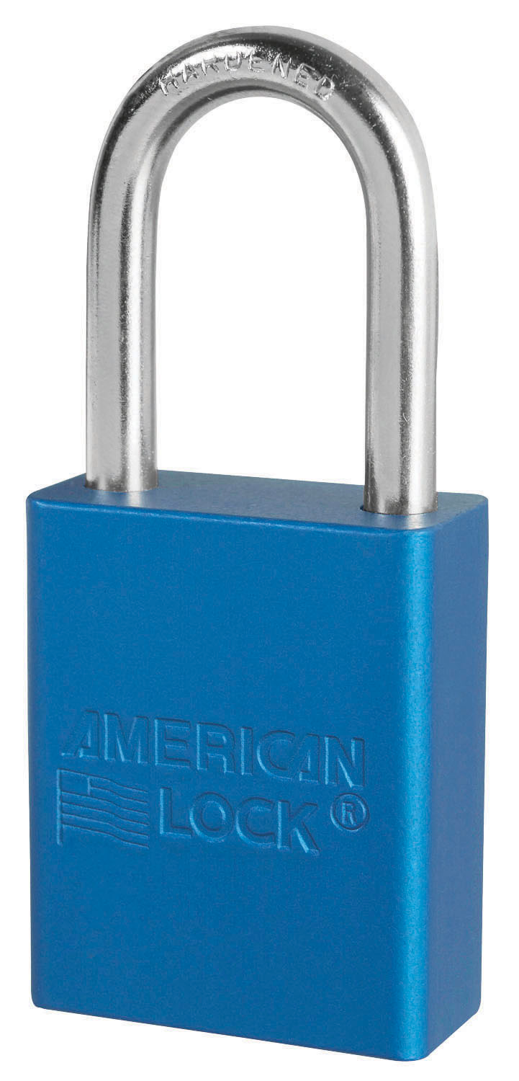
The TCP bytestream model
Client
ABCDEF...111232
Server
0988989 ... XYZZ
IP:1.2.3.4
IP:4.5.6.7

Slide 6
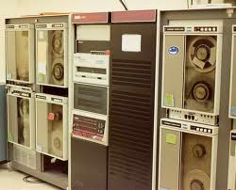

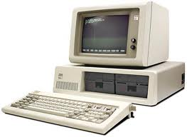

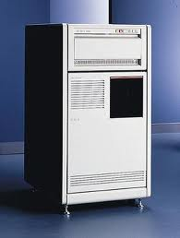

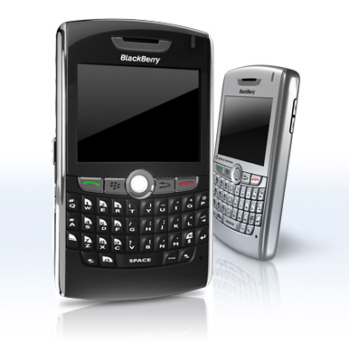
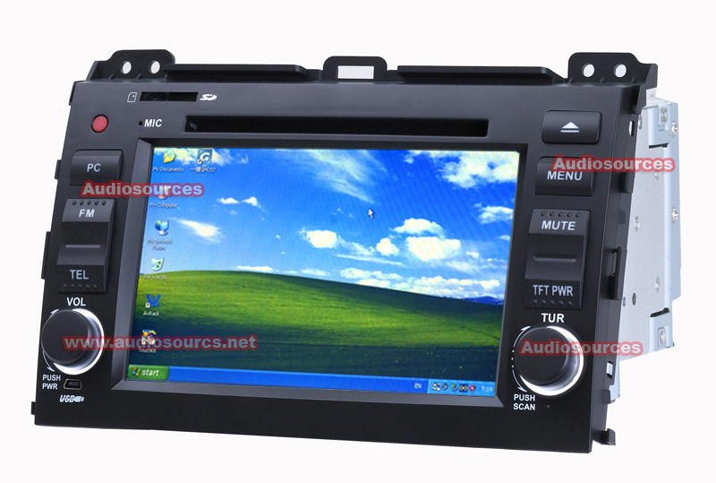
Endhosts have evolved
Mobile devices have multiple wireless interfaces and those using a single interface often support IPv4 and IPv6

Slide 7
Two main types of use cases
Seamless handovers on smartphones
With Multipath TCP, connections persit on smartphones even when they move from Wi-Fi to cellular and back
Bandwidth aggregation
With Multipath TCP, heterogeneous networks can be combined to obtain higher bandwidth

Slide 8

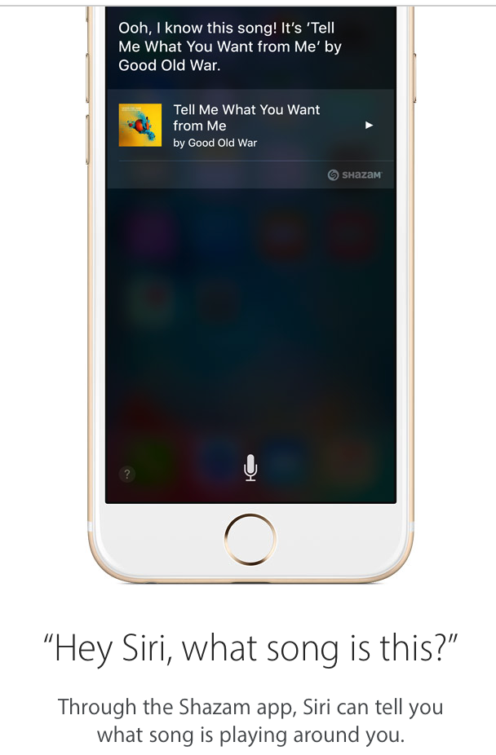
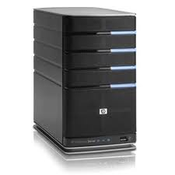
Multipath TCP use cases Low latency for Siri
Long-lived TLS connections
WiFi
Voice samples
Voice samples
3G/LTE

Slide 9
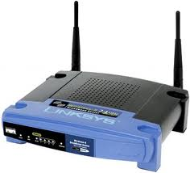
Walking with Siri in 2012
Wi-Fi lost, attach to cellular
xG celltower
IP 1.2.3.4
Restart TCP connection and send voice again…
Wi-Fi still attached but flappy
Voice samples
IP 5.6.7.8
Siri uses long-lived TLS connections
Notes:
ajouter adresse ip

Slide 10
Walking with Siri and Multipath TCP
Wi-Fi lost
xG celltower
Multipath TCP enables retransmission on cellular
Multipath TCP connection continues over cellular
Wi-Fi still attached but flappy
IP 1.2.3.4
Voice samples
IP 5.6.7.8
Cellular available as backup
Same applies to Apple Music and Apple Maps
Notes:
ajouter adresse ip

Slide 11
Limitations of this use case today
Multipath TCP needed on smartphone+server
Smartphone support for Multipath TCP
Apple iOS since 2013, initially for Siri only and later for third-party applications and also Maps and Music
Android, not part of the official release (Linux kernel)
Samsung, LG, Huawei use it in specific markets
Server support
Well tested Linux patch https://www.multipath-tcp.org
Ongoing work to bring it to mainline Linux kernel
Load balancers
Duchene, F., & Bonaventure, O. (2017, October). Making Multipath TCP friendlier to load balancers and anycast. In 2017 IEEE 25th International Conference on Network Protocols (ICNP) (pp. 1-10). IEEE.

Slide 12

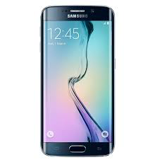



Multipath TCP use cases High bandwidth on smartphones
Koreans want 800+ Mbps on smartphones
WiFi
Multipath TCP
Regular TCP
SOCKS
MPTCP<->TCP Proxy
4G/LTE
Bonaventure, O., and Seo, S.. "Multipath TCP deployments." IETF Journal 12.2 (2016): 24-27.

Slide 13

5G/Wi-Fi coexistence
Same approach as for hybrid access networks
WiFi
Multipath TCP
Regular TCP
ATSSS: Access Traffic Steering, Switching and Splitting
MPTCP<->TCP Proxy
5G
Bonaventure, O., Boucadair, M. et al. ”0-RTT Convert Protocol" RFC8803, 2020
https://tools.ietf.org/html/rfc8803

Slide 14
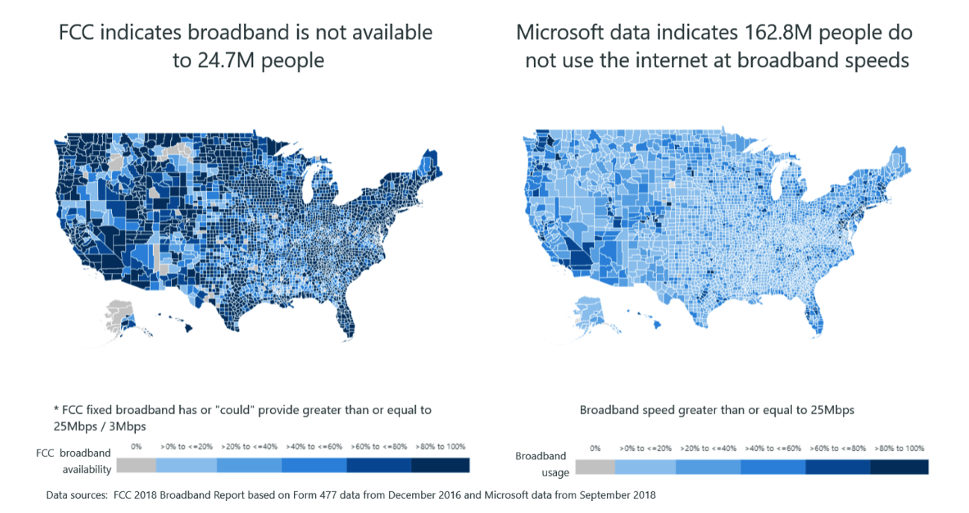
Broadband in the USA
Source: https://blogs.microsoft.com/on-the-issues/2019/04/08/ its-time-for-a-new-approach-for-mapping-broadband-data-to-better-serve-americans/

Slide 15
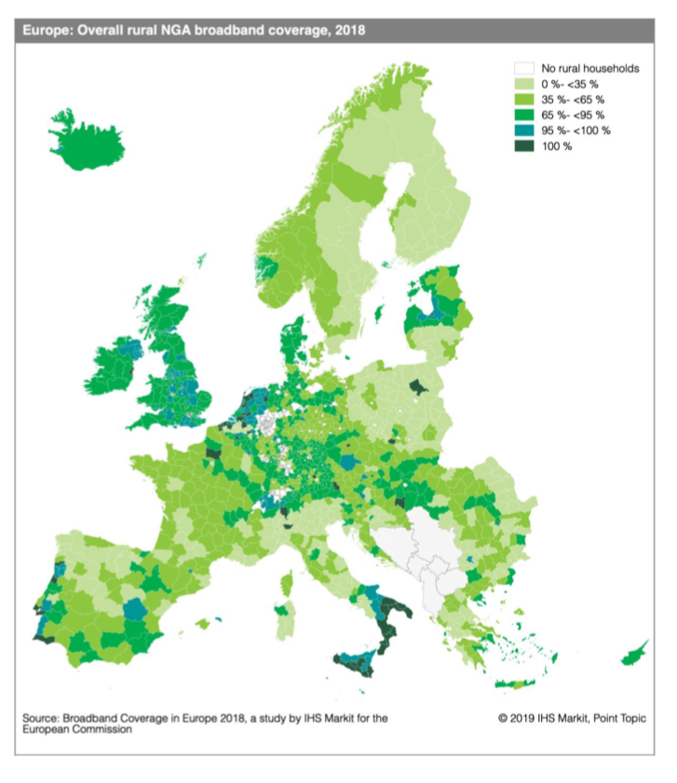
Fast broadband in rural areas Europe
Source: https://ec.europa.eu/digital-single-market/en/news/study-broadband-coverage-europe-2018

Slide 16
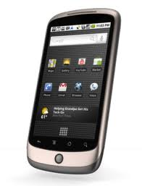
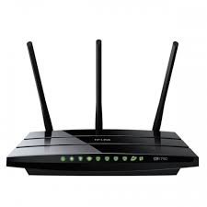

Hybrid Access Networks
DSL
TCP
Multipath TCP
Regular TCP
TCP
TCP<->MPTCP Proxy
Hybrid Access
Gateway
MPTCP<->TCP Proxy
4G/LTE
Keukeleire, N., et al. (2020). Increasing Broadband Reach with Hybrid Access Networks. IEEE Communications Standards Magazine, 4(1), 43-49.

Slide 17
Other use cases
Multipath TCP on servers
Can load-balance over heterogeneous links
Ongoing effort for MPTCP in mainline Linux kernel
Multipath TCP in datacenters
Proposed in SIGCOMM’11 paper, but not yet deployed AFAIK
Multipath TCP on dual-stack hosts
Performance of IPv4 and IPv6 paths often differ
Multipath TCP would automatically select the best
If you know other deployments, let me know !
http://blog.multipath-tcp.org/blog/html/2018/12/01/multipath_tcp_a_retrospective.html

Slide 18
Agenda
Why Multipath TCP ?
Barriers to Multipath TCP
A closer look at the Multipath TCP protocol

Slide 19
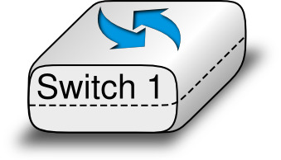
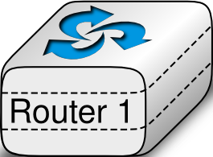

The Internet architecture that we explain to our students
Application
Transport
Datalink
Network
Physical
Datalink
Physical
Network
Datalink
Physical
Physical
O. Bonaventure, et al. Computer networking : Principles, Protocols and Practice, open ebook, https://www.computer-networking.info

Slide 20
A typical "academic" network
Application
Application
TCP
Transport
Transport
Network
Network
Network
Datalink
Datalink
Datalink
Datalink
Physical
Physical
Physical
Physical

Slide 21
The end-to-end principle
Application
Application
TCP
Transport
Transport
Network
Network
Network
Datalink
Datalink
Datalink
Datalink
Physical
Physical
Physical
Physical

Slide 22
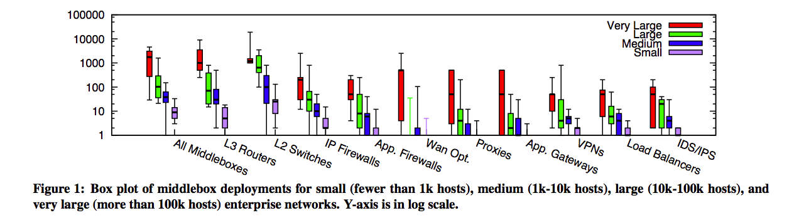
In reality
almost as many middleboxes as routers
various types of middleboxes are deployed
Sherry, Justine, et al. "Making middleboxes someone else's problem: Network processing as a cloud service." Proceedings of the ACM SIGCOMM 2012 conference. ACM, 2012.
Honda, Michio, et al. "Is it still possible to extend TCP?" Proceedings of the 2011 ACM SIGCOMM conference on Internet measurement conference. ACM, 2011.

Slide 23
A middlebox zoo
Web Security Appliance
VPN Concentrator
SSL Terminator
NAC Appliance
ACE XML Gateway
PIX Firewall Right and Left
Cisco IOS Firewall
IP Telephony Router
Voice Gateway
Streamer
NAT
Content Engine
http://www.cisco.com/web/about/ac50/ac47/2.html

Slide 24
TCP segments processed by a router
Ver IHL ToS
Total length
Ver IHL ToS
Total length
Identification
Flags Frag. Offset
Identification
Flags Frag. Offset
IP
TTL Protocol
Checksum
TTL Protocol
Checksum
Source IP address
Source IP address
Destination IP address
Destination IP address
Source port
Destination port
Source port
Destination port
Sequence number
Sequence number
Acknowledgment number
Acknowledgment number
TCP
THL Reserved Flags
Window
THL Reserved Flags
Window
Checksum
Urgent pointer
Checksum
Urgent pointer
Options
Options
Payload
Payload

Slide 25
TCP segments processed by a NAT
Ver IHL ToS
Total length
Ver IHL ToS
Total length
Identification
Flags Frag. Offset
Identification
Flags Frag. Offset
TTL Protocol
Checksum
TTL Protocol
Checksum
Source IP address
Source IP address
Destination IP address
Destination IP address
Source port
Destination port
Source port
Destination port
Sequence number
Sequence number
Acknowledgment number
Acknowledgment number
THL Reserved Flags
Window
THL Reserved Flags
Window
Checksum
Urgent pointer
Checksum
Urgent pointer
Options
Options
Payload
Payload
Notes:
c

Slide 26

How to model those middleboxes ?
In the official architecture, they do not exist
In reality...
Application
Application
Application
TCP
Transport
Transport
Transport
Network
Network
Network
Network
Datalink
Datalink
Datalink
Datalink
Physical
Physical
Physical
Physical

Slide 27
TCP segments processed by an ALG running on a NAT
Ver IHL ToS
Total length
Ver IHL ToS
Total length
Identification
Flags Frag. Offset
Identification
Flags Frag. Offset
TTL Protocol
Checksum
TTL Protocol
Checksum
Source IP address
Source IP address
Destination IP address
Destination IP address
Source port
Destination port
Source port
Destination port
Sequence number
Sequence number
Acknowledgment number
Acknowledgment number
THL Reserved Flags
Window
THL Reserved Flags
Window
Checksum
Urgent pointer
Checksum
Urgent pointer
Options
Options
Payload
Payload

Slide 28
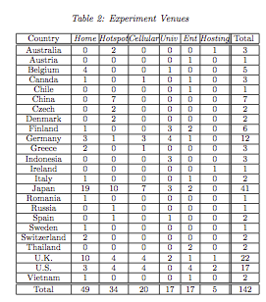
How transparent is the Internet ?
25th September 2010 to 30th April 2011
142 access networks
24 countries
Sent specific TCP segments from client to a server in Japan
Honda, Michio, et al. "Is it still possible to extend TCP?" Proceedings of the 2011 ACM SIGCOMM conference on Internet measurement conference. ACM, 2011.

Slide 29
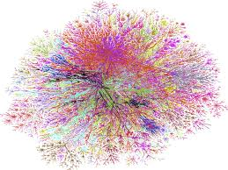
End-to-end transparency today
Ver IHL ToS
Total length
Ver IHL ToS
Total length
Identification
Flags Frag. Offset
Identification
Flags Frag. Offset
Middleboxes don't change
the Protocol field, but
many discard packets with an unknown Protocol field
TTL Protocol
Checksum
TTL Protocol
Checksum
Source IP address
Source IP address
Destination IP address
Destination IP address
Source port
Destination port
Source port
Destination port
Sequence number
Sequence number
Acknowledgment number
Acknowledgment number
THL Reserved Flags
Window
THL Reserved Flags
Window
Checksum
Urgent pointer
Checksum
Urgent pointer
Options
Options
Payload
Payload

Slide 30
TCP segments processed by a NAT (2)
active mode ftp behind a NAT
220 ProFTPD 1.3.3d Server (BELNET FTPD Server) [193.190.67.15]
ftp_login: user `<null>' pass `<null>' host `ftp.belnet.be'
Name (ftp.belnet.be:obo): anonymous
---> USER anonymous
331 Anonymous login ok, send your complete email address as your password
Password:
---> PASS XXXX
---> PORT 192,168,0,7,195,120
200 PORT command successful
---> LIST
150 Opening ASCII mode data connection for file list
lrw-r--r-- 1 ftp ftp 6 Jun 1 2011 pub -> mirror
226 Transfer complete

Slide 31
Agenda
Why Multipath TCP ?
Barriers to Multipath TCP
A closer look at the Multipath TCP protocol

Slide 32
Design objectives
Multipath TCP is an evolution of TCP
Design objectives
Support unmodified applications
Work over today’s networks (IPv4 and IPv6)
Works in all networks where regular TCP works

Slide 33
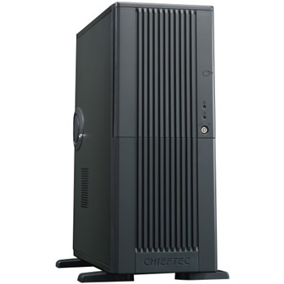
TCP Connection establishment
Three-way handshake
SYN,seq=1234,Options
SYN+ACK,ack=1235,seq=5678,Options
ACK,seq=1235,ack=5679

Slide 34
Data transfer
seq=1234,"abcd"
ACK,ack=1238,win=4
seq=1238,"efgh"
ACK,ack=1242,win=0

Slide 35
Connection release
seq=1234,"abcd"
RST

Slide 36
Connection release
seq=1234,"abcd"
FIN, seq=1238
ACK,ack=1239
seq=345,"ijkl"
FIN,seq=349
FIN,ack=350

Slide 37
Identification of a TCP connection
Four tuple
IP_{source}
IP_{dest}
Port_{source}
Port_{dest}
All TCP segments contain the four tuple
Ver IHL ToS
Total length
Identification
Flags Frag. Offset
IP
TTL Protocol
Checksum
Source IP address
Destination IP address
Source port
Destination port
Sequence number
Acknowledgment number
TCP
THL Reserved Flags
Window
Checksum
Urgent pointer
Options
Payload

Slide 38
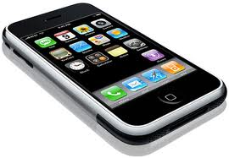
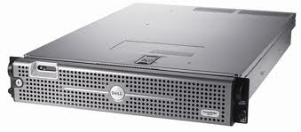
The new bytestream model
Client
ABCDEF...111232
Server
0988989 ... XYZZ
D
C
B
A
IP:2.3.4.5
IP:6.7.8.9
IP:1.2.3.4
IP:4.5.6.7
38
Notes:
arrive fort tard

Slide 39
The Multipath TCP protocol
Control plane
How to manage a Multipath TCP connection that uses several paths ?
Data plane
How to transport data ?
Congestion control
How to control congestion over multiple paths ?

Slide 40
A naïve Multipath TCP
SYN+Option
SYN+ACK+Option
ACK
seq=123, "abc"
seq=126, "def"

Slide 41
A naïve Multipath TCP In today's Internet ?
SYN+Option
SYN+ACK+Option
ACK
seq=123, "abc"
There is no corresponding TCP connection
seq=126, "def"

Slide 42
Design decision
A Multipath TCP connection is composed of one or more regular TCP subflows that are combined
Each host maintains state that glues the TCP subflows that compose a Multipath TCP connection together
Each TCP subflow is sent over a single path and appears like a regular TCP connection along this path

Slide 43
Multipath TCP and the architecture
Application
socket
Application
Multipath TCP
Transport
TCP1
TCP2
TCPn
Network
...
Datalink
Physical
IPv4
IPv6
A. Ford, C. Raiciu, M. Handley, S. Barre, and J. Iyengar, “Architectural guidelines for multipath TCP development", RFC6182 2011.

Slide 44
A regular TCP connection
What is a regular TCP connection ?
It starts with a three-way handshake
SYN segments may contain special options
All data segments are sent in sequence
There is no gap in the sequence numbers
It is terminated by using FIN or RST

Slide 45
Multipath TCP
SYN+MP_CAPABLE
SYN+ACK+MP_CAPABLE
ACK+MP_CAPABLE
SYN+MP_JOIN
SYN+ACK+MP_JOIN
ACK

Slide 46
How to combine two TCP subflows ?
SYN+MP_CAPABLE
SYN+ACK+ MP_CAPABLE
ACK+MP_CAPABLE
SYN+MP_JOIN
How to link with
blue subflow ?
SYN+ACK+MP_JOIN
ACK

Slide 47
How to link TCP subflows ?
SYN, Port_{src}=1234,Port_{dst}=80+MP_CAPABLE
SYN+ACK[...]
A NAT could change addresses and port numbers
ACK
SYN, Port_{src}=1235,Port_{dst}=80
+MP_JOIN[link Port_{src}=1234,Port_{dst}=80]

Slide 48
How to link TCP subflows ?
SYN, Port_{src}=1234,Port_{dst}=80 +MP_CAPABLE
SYN+ACK+MP_CAPABLE[Token=6543]
ACK+MP_CAPABLE [Token=5678]
MyToken=5678
YourToken=6543
MyToken=6543
YourToken=5678
SYN, Port_{src}=1235,Port_{dst}=80
+MP_JOIN[Token=6543]

Slide 49
TCP subflows
Which subflows can be associated to a Multipath TCP connection ?
At least one of the elements of the four-tuple needs to differ between two subflows
Local IP address
Remote IP address
Local port
Remote port

Slide 50
Subflow agility
Multipath TCP supports
addition of subflows
removal of subflows

Slide 51
The Multipath TCP protocol
Control plane
How to manage a Multipath TCP connection that uses several paths ?
Data plane
How to transport data ?
Congestion control
How to control congestion over multiple paths ?

Slide 52
How to transfer data ?
seq=123,"a"
ack=124
seq=125,"c"
ack=126
seq=124,"b"
ack=125
seq=126,"d"
ack=127

Slide 53
How to transfer data in today's Internet ?
seq=123,"a"
ack=124
seq=125,"c"
ack=126
Gap in sequence numbering space
Some DPI will not allow this !
seq=124,"b"
ack=125

Slide 54
Multipath TCP Data transfer
Two levels of sequence numbers
ABCDEF
socket
socket
Multipath TCP
Multipath TCP
Data sequence #
TCP1
TCP1 sequence #
TCP1
TCP2
TCP2 sequence #
TCP2

Slide 55
Multipath TCP Data transfer
Dseq=0,seq=123,"a"
DAck=1,ack=124
DSeq=2, seq=124,"c"
DAck=3, ack=125
DSeq=1, seq=456,"b"
DAck=2,ack=457

Slide 56
Multipath TCP How to deal with losses ?
Data losses over one TCP subflow
Fast retransmit and timeout as in regular TCP
Dseq=0,seq=123,"a"
DAck=1,ack=124
Dseq=0,seq=123,"a"
DAck=1,ack=124

Slide 57
Multipath TCP
What happens when a TCP subflow fails ?
Dseq=0,seq=123,"a"
DSeq=1, seq=456,"b"
DAck=0,ack=457
Dseq=0,seq=457,"a"
DAck=2,ack=458

Slide 58
Retransmission heuristics
Heuristics used by current Linux implementation
Fast retransmit is performed on the same subflow as the original transmission
Upon timeout expiration, reevaluate whether the segment could be retransmitted over another subflow
Upon loss of a subflow, all the unacknowledged data are retransmitted on other subflows

Slide 59
Flow control
How should the window-based flow control be performed ?
Independant windows on each TCP subflow
A single window that is shared among all TCP subflows

Slide 60
Independant windows
Dseq=0,seq=123,"a"
DAck=1,ack=124,win=0
DSeq=1, seq=456,"b"
DAck=2,ack=457,win=100
Dseq=2,seq=457,"c"
DAck=3,ack=458,win=100

Slide 61
Independant windows possible problem
Dseq=0,seq=123,"a"
DSeq=1, seq=456,"b"
DAck=2,ack=457,win=0
Impossible to retransmit, window is already full on green subflow

Slide 62
A single window shared by all subflows
Dseq=0,seq=123,"a"
DAck=1,ack=124,win=10
DSeq=1, seq=456,"b"
DAck=2,ack=457,win=10
Dseq=2,seq=457,"c"
DAck=3,ack=458,win=10

Slide 63
Multipath TCP Windows
Multipath TCP maintains one window per Multipath TCP connection
Window is relative to the last acked data (Data Ack)
Window is shared among all subflows
It's up to the implementation to decide how the window is shared
Window is transmitted inside the window field of the regular TCP header
If middleboxes change window field,
use largest window received at MPTCP-level
use received window over each subflow to cope with the flow control imposed by the middlebox

Slide 64
Multipath TCP buffers
MPTCP-level, resequencing possible
send(...)
recv(...)
socket
Scheduler
Multipath TCP
TCP1
TCP2
Transmit queues, process only regular TCP header
Reorder queue, processes only TCP header

Slide 65
Multipath TCP Data sequence numbers
What should be the length of the data sequence numbers ?
32 bits
compact and compatible with TCP
wrap around problem at highspeed requires PAWS
64 bits
wrap around is not an issue anymore
takes more space inside each segment

Slide 66
Multipath TCP Data sequence numbers
Data sequence numbers and Data acknowledgements
Maintained inside implementation as 64 bits field
Implementations can, as an optimisation, only transmit the lower 32 bits of the data sequence and acknowledgements

Slide 67
Other types of middlebox interference
Your favorite high-speed NIC
GRO: Consecutive TCP segments can be merged
TSO: A large TCP segment will be split in segments
DSS is a mapping from DataSeq to SeqNum for a specific number of bytes
Application Level Gateway “modifies” payload
Adding/Removing bytes is a problem
DSS includes optional checksum to detect this and reset affected subflow or fallback TCP

Slide 68
Multipath TCP option
A single option type
to minimise the risk of having one option accepted by middleboxes in SYN segments and rejected in segments carrying data
Kind Length
Subtype
Subtype specific data
(variable length)

Slide 69
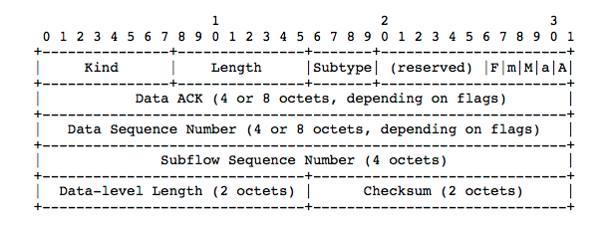
Data Sequence Signal option
A = Data ACK present
a = Data ACK is 8 octets
M = mapping present
m = DSN is 8
Cumulative Data ack
Length of mapping, can extend beyond this segment
Computed over data covered by entire mapping + pseudo header

Slide 70
The Multipath TCP protocol
Control plane
How to manage a Multipath TCP connection that uses several paths ?
Data plane
How to transport data ?
Congestion control
How to control congestion over multiple paths ?

Slide 71
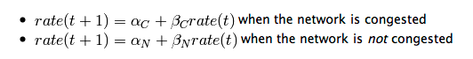
TCP congestion control
A linear rate adaption algorithm
To be fair and efficient, a linear algorithm must use additive increase and multiplicative decrease (AIMD)
# Additive Increase Multiplicative Decrease
if congestion :
rate=rate*betaC # multiplicative decrease, betaC<1
else
rate=rate+alphaN # additive increase, v0>0

Slide 72
AIMD in TCP
Congestion control mechanism
Each host maintains a congestion window (cwnd)
No congestion
Congestion avoidance (additive increase)
increase cwnd by one segment every round-trip-time
Congestion
TCP detects congestion by detecting losses
Mild congestion (fast retransmit – multiplicative decrease)
cwnd=cwnd/2 and restart congestion avoidance
Severe congestion (timeout)
cwnd=1, set slow-start-threshold and restart slow-start

Slide 73
Congestion control for Multipath TCP
Simple approach
independant congestion windows
Threshold
Threshold
Threshold

Slide 74
Independent congestion windows
Problem
12Mbps

Slide 75
Coupled congestion control
Congestion windows are coupled
congestion window growth cannot be faster than TCP with a single flow
Coupled congestion control aims at moving traffic away from congested path

Slide 76
Linked increases congestion control
Algorithm
Multiplicative Decrease
For each loss on path r, cwin_{r}=cwin_{r}/2
Additive increase
D. Wischik, C. Raiciu, A. Greenhalgh, and M. Handley, “Design, implementation and evaluation of congestion control for multipath TCP,” NSDI'11: Proceedings of the 8th USENIX conference on Networked systems design and implementation, 2011.

Slide 77
Other Multipath-aware congestion control schemes
R. Khalili, N. Gast, M. Popovic, U. Upadhyay, J.-Y. Le Boudec , MPTCP is not Pareto-optimal: Performance issues and a possible solution, Proc. ACM Conext 2012
Y. Cao, X. Mingwei, and X. Fu, “Delay-based Congestion Control for Multipath TCP,” ICNP2012, 2012.
T. A. Le, C. S. Hong, and E.-N. Huh, “Coordinated TCP Westwood congestion control for multiple paths over wireless networks,” ICOIN '12: Proceedings of the The International Conference on Information Network 2012, 2012, pp. 92–96.
T. A. Le, H. Rim, and C. S. Hong, “A Multipath Cubic TCP Congestion Control with Multipath Fast Recovery over High Bandwidth-Delay Product Networks,” IEICE Transactions, 2012.
T. Dreibholz, M. Becke, J. Pulinthanath, and E. P. Rathgeb, “Applying TCP-Friendly Congestion Control to Concurrent Multipath Transfer,” Advanced Information Networking and Applications (AINA), 2010 24th IEEE International Conference on, 2010, pp. 312–319.

Slide 78
Multipath TCP packet schedulers
When several subflows are active, the packet scheduler selects the subflow where each packet is sent
Default scheduler is to prefer subflow having the lowest round-trip-time
Well adapted to NewReno like congestion control
Other schedulers have been proposed
Round Robin, Priority
Schedulers that schedule packets by estimating the time required to reach the receiver to avoid reodering
https://tools.ietf.org/html/draft-bonaventure-iccrg-schedulers

Slide 79
The Multipath TCP protocol
Control plane
How to manage a Multipath TCP connection that uses several paths ?
Data plane
How to transport data ?
Congestion control
How to control congestion over multiple paths ?

Slide 80
Multipath TCP Connection establishment
Principle
SYN, MP_CAPABLE
SYN+ACK, MP_CAPABLE
How to verify that
SYN+MP_JOIN comes from client of blue subflow ?
ACK, MP_CAPABLE
seq=123, DSeq=1, "abc"
SYN+MP_JOIN

Slide 81
Roles of the initial TCP handshake
Check willingness to open TCP connection
Propose initial sequence number
Negotiate Maximum Segment Size
TCP options
negotiate Timestamps, SACK, Window scale
Multipath TCP
check that server supports Multipath TCP
propose Token in each direction
propose initial Data sequence number in each direction
Exchange keys to authenticate subflows

Slide 82
« Authenticating » Multipath TCP subflows
Main goal
Prevent attacks by off-path attackers
Principles
Each host announces a key during initial handshake
keys are exchanged in clear
When establishing a subflow, use HMAC + key to authenticate subflow

Slide 83
Key exchange
SYN, MPC
SYN+ACK, MPC[MyKey="keyDEF"]
ACK MPC[MyKey="keyABC", YourKey="keyDEF"]
MyKey="keyABC"
MyKey="keyDEF"
YourKey="keyDEF"
YourKey="keyABC"
SYN,MP_JOIN[NonceA=123]
SYN+ACK[NonceB=456, HMAC(123||456,"keyDEF||keyABC")]
ACK,[HMAC(456||123,"keyABC||keyDEF")]

Slide 84
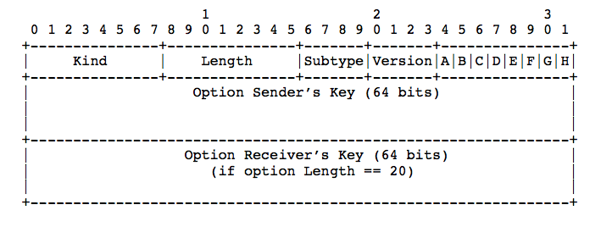
The MP_CAPABLE option
Load balancers
A: DSN Checksum
required or not
Used inside SYN+ACK
In SYN+ACK and third ACK

Slide 85
Initial Data Sequence Numbers and Tokens
Computation of initial Data Sequence Number
Computation of token
IDSN_{A}=Lower₆₄(SHA-1(Key_{A}))
IDSN_{B}=Lower₆₄(SHA-1(Key_{B}))
There is a small risk of collision,
different keys
same token
Token_{A}=Upper₃₂(SHA-1(Key_{A}))
Token_{B}=Upper₃₂(SHA-1(Key_{B}))

Slide 86
The Multipath TCP control plane
Connection establishment in details
Closing a Multipath TCP connection
Address dynamics

Slide 87
Closing a Multipath TCP connection
seq=123, DSS[1->123 ...], "ab"
seq=125, DSS[5->125,DATA_FIN ...], "end"
DAck=9,ack=128
seq=128, FIN
ack=129
seq=456, DSS[3->456], "cd"
DAck=5,ack=458

Slide 88
Quickly closing a Multipath TCP connection
How to quickly close a Multipath TCP connection ?
By closing all subflows ?
RST
RST

Slide 89
Closing a Multipath TCP connection
FAST Close
SYN, [...]
SYN+ACK, [...]
ACK[...]
ACK+FAST_CLOSE(ClientKey)
RST
SYN,[...]
SYN+ACK[...]
ACK[..]
RST

Slide 90
The Multipath TCP control plane
Connection establishment in details
Closing a Multipath TCP connection
Address dynamics

Slide 91
Multipath TCP Address dynamics
How to learn the addresses of a host ?
How to deal with address changes ?
IP=2.3.4.5
IP=3.4.5.6
IP6=2a00:1450:400c:c05::69
IP=1.2.3.4
IP=4.5.6.7

Slide 92
Address dynamics
Basic solution : multihomed server
SYN, [...]
SYN+ACK, [...]
ACK[...]
ADD_ADDR[3.4.5.6]
IP=2.3.4.5
IP=3.4.5.6
IP6=2a00:1450:400c:c05::69
ADD_ADDR[2a00:1450:400c:c05::69]
SYN,[...]
SYN+ACK[...]
ACK[..]

Slide 93
Address dynamics
Basic solution : mobile client
SYN, [...]
SYN+ACK, [...]
ACK[...]
ADD_ADDR [4.5.6.7]
IP=2.3.4.5
SYN,[...]
IP=1.2.3.4
SYN+ACK[...]
IP=4.5.6.7
ACK[..]
REMOVE_ADDR[1.2.3.4]

Slide 94
Address dynamics in today's Internet
SYN, [...]
SYN+ACK, [...]
ACK[...]
ADD_ADDR [10.0.0.2]
ADD_ADDR [10.0.0.2]
NAT
IP=2.3.4.5
IP=1.2.3.4
?
SYN [...]
IP=10.0.0.2

Slide 95
Address dynamics with NATs
Solution
Each address has one identifier
Subflow is established between id=0 addresses
Each host maintains a list of <address,id> pairs of the addresses associated to an MPTCP endpoint
MPTCP options refer to the address identifier
ADD_ADDR contains <address,id>
REMOVE_ADDR contains <id>

Slide 96
Address dynamics
SYN, [...]
SYN+ACK, [...]
ACK[...]
ADD_ADDR [4.5.6.7,id=1]
IP=2.3.4.5
SYN,[id=1...]
IP=1.2.3.4
SYN+ACK[...]
IP=4.5.6.7
ACK[..]
REMOVE_ADDR[id=0]

Slide 97
The Multipath TCP Path Manager
Leverages the information about
Local IP addresses and interface state
Remote IP addresses
Decides to create and terminate subflows
Sample path managers
Full mesh : one subflow between each pair addr.
Ndiffports: for single-homed hosts, n parallel flows
Use case specific path managers

Slide 98

Multipath TCP aware load-balancers
SYN, MPC
SYN, MPC
SYN+ACK, MPC[C=1,...]
ACK MPC[...]
ACK[...]
IP=2.3.4.5
IP=3.4.5.6
IP=3.4.5.7
IP=1.2.3.4
ADD_ADDR[3.4.5.6]
SYN,[...]
SYN+ACK[...]
ACK[..]
Duchene, F., & Bonaventure, O. (2017, October). Making Multipath TCP friendlier to load balancers and anycast. In 2017 IEEE 25th International Conference on Network Protocols (ICNP) (pp. 1-10). IEEE.

Slide 99





Conclusion
Multipath TCP is a reality
Many scientific papers (see references)
Due to the middleboxes, the protocol is more complex than initially expected
Multipath TCP works over today's Internet !
Large scale deployments
What's next ?
Ongoing effort to integrate it in the mainline Linux kernel for wider deployment

Slide 100
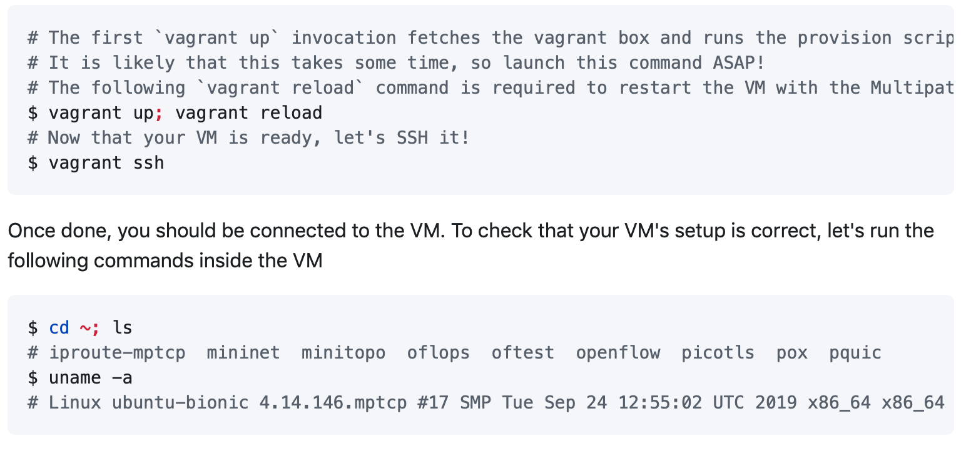
Hands-on
https://github.com/qdeconinck/sigcomm20_mptp_tutorial
First check that the VM is working correctly

Slide 101
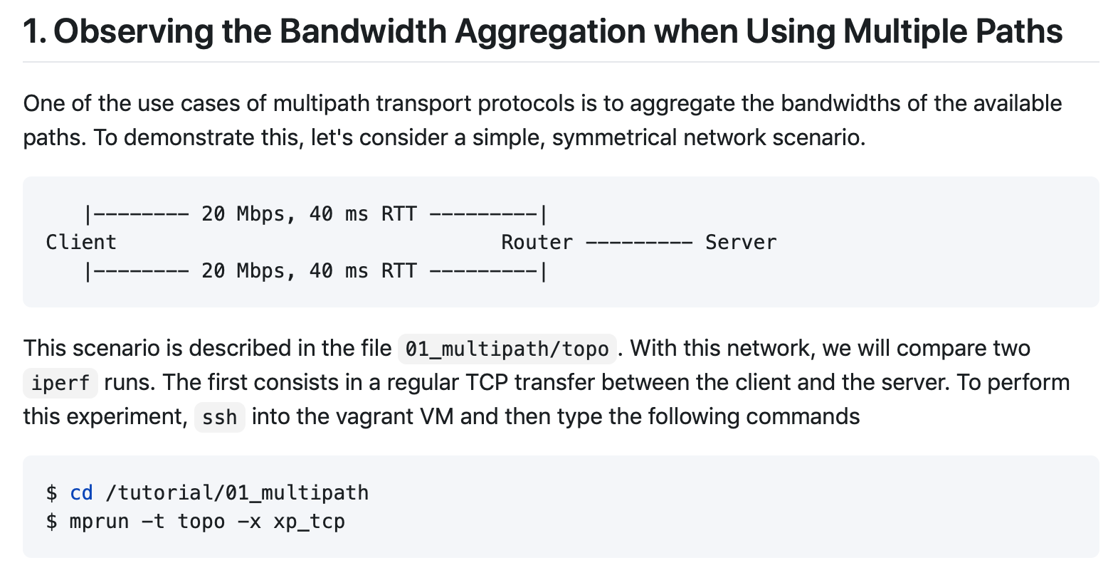
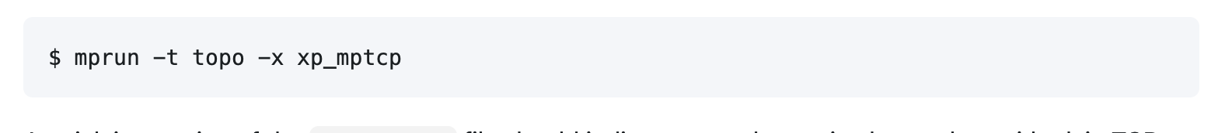
Hands-on : bandwidth aggregation

Slide 102
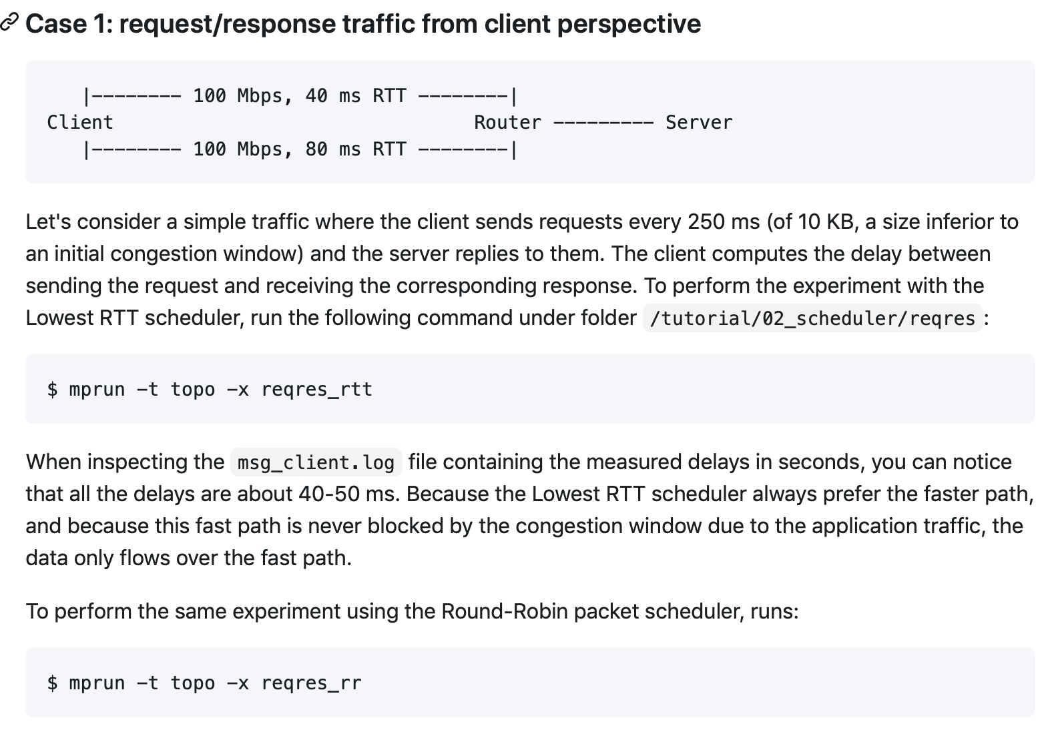
Comparing packet schedulers

Slide 103
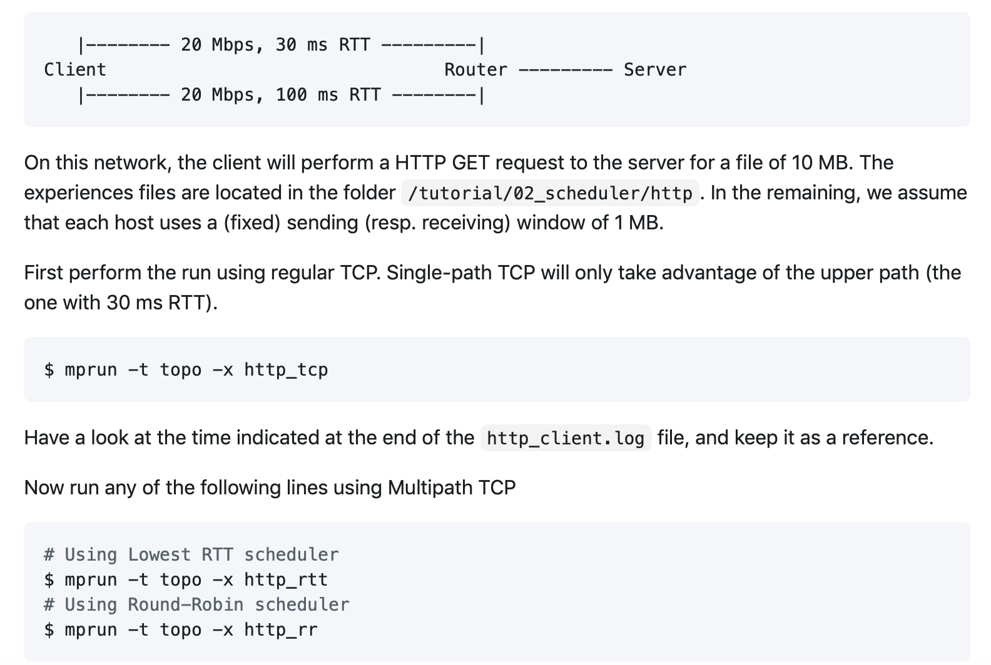
Comparing packet schedulers (2)

Slide 104
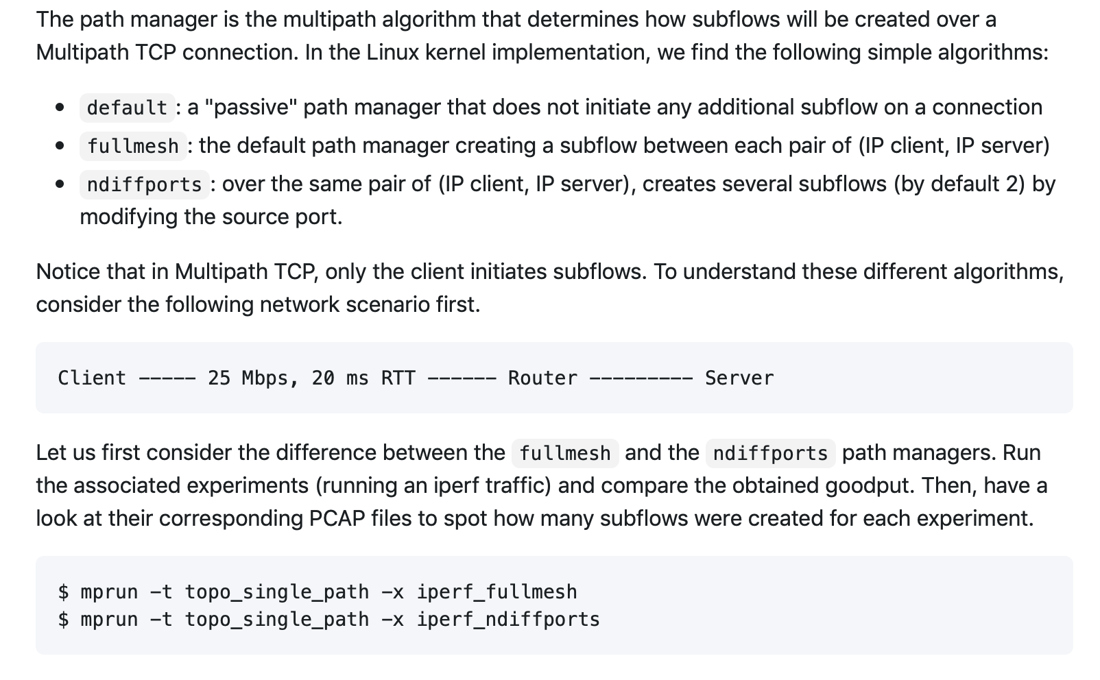
Path managers

Slide 105
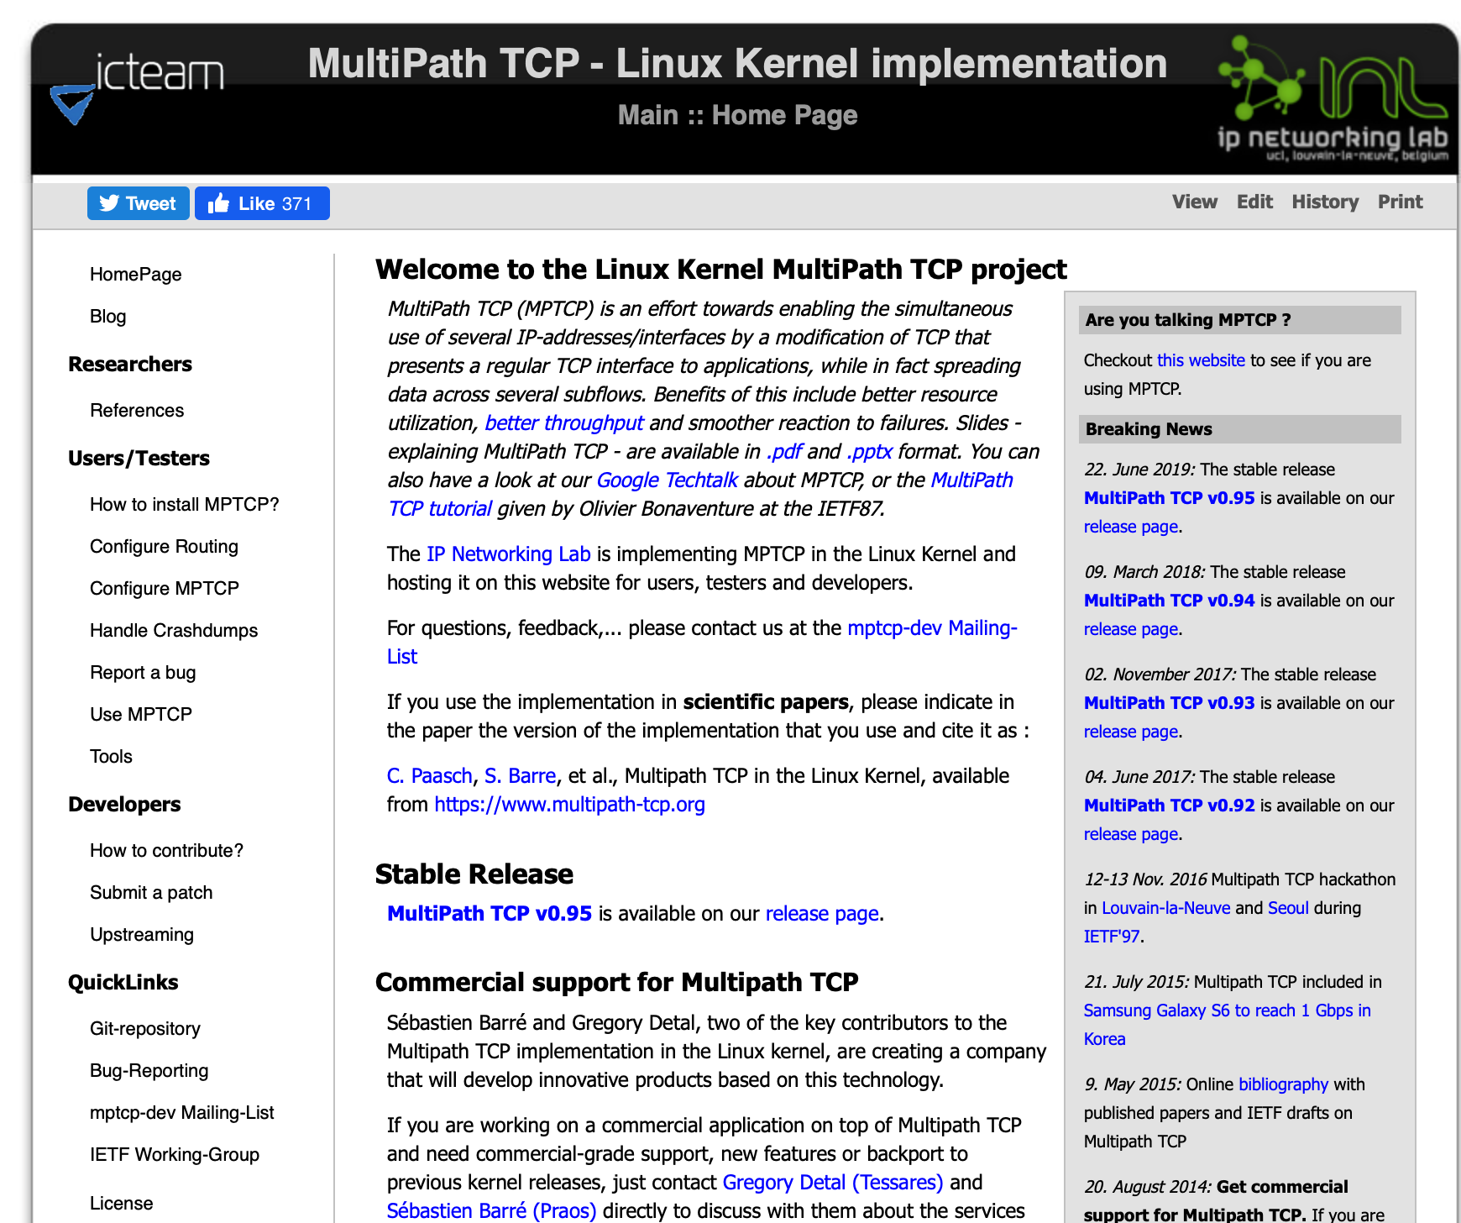
Try it by yourself ! https://multipath-tcp.org

Slide 106
References
The Multipath TCP protocol
https://www.multipath-tcp.org
http://tools.ietf.org/wg/mptcp/
A. Ford, C. Raiciu, M. Handley, S. Barre, and J. Iyengar, “Architectural guidelines for Multipath TCP development", RFC6182 2011.
A. Ford, C. Raiciu, M. J. Handley, and O. Bonaventure, “TCP Extensions for Multipath Operation with Multiple Addresses,” RFC6824, 2013
A. Ford, C. Raiciu, M. J. Handley, and O. Bonaventure, C. Paasch, “TCP Extensions for Multipath Operation with Multiple Addresses,” RFC8684, 2020
C. Raiciu, C. Paasch, S. Barre, A. Ford, M. Honda, F. Duchene, O. Bonaventure, and M. Handley, “How hard can it be? designing and implementing a deployable multipath TCP,” NSDI'12: Proceedings of the 9th USENIX conference on Networked Systems Design and Implementation, 2012.

Slide 107
Multipath TCP : RFCs
RFC6181: Threat Analysis for TCP Extensions for Multipath Operation with Multiple Addresses
RFC6182: Architectural Guidelines for Multipath TCP Development
RFC6356: Coupled Congestion Control for Multipath Transport Protocols
RFC6824: TCP Extensions for Multipath Operation with Multiple Addresses (v0)
RFC6897: Multipath TCP (MPTCP) Application Interface Considerations
RFC7430: Analysis of Residual Threats and Possible Fixes for Multipath TCP (MPTCP)
RFC8041: Use Cases and Operational Experience with Multipath TCP
RFC8684: TCP Extensions for Multipath Operation with Multiple Addresses (v1)

Slide 108
Implementations
Linux
Patches to different kernel versions supporting v0
http://www.multipath-tcp.org
https://github.com/multipath-tcp
Ongoing effort by RedHat, Apple, intel and Tessares to include Multipath TCP v1 in mainline Linux
https://github.com/multipath-tcp/mptcp_net-next/wiki
Apple
Included in iOS and MacOS
FreeBSD (not updated)
http://caia.swin.edu.au/urp/newtcp/mptcp/

Slide 109
Multipath TCP tutorials and surveys
Paasch, C., & Bonaventure, O. (2014). Multipath tcp. Communications of the ACM, 57(4), 51-57.
Raiciu, C., Iyengar, J., & Bonaventure, O. (2013). Recent advances in reliable transport protocols. SIGCOMM ebook on Recent Advances in Networking.
Bonaventure, O., Handley, M., & Raiciu, C. (2012). An overview of Multipath TCP. ; login:, 37(5), 17.
Li, M., Lukyanenko, A., Ou, Z., Ylä-Jääski, A., Tarkoma, S., Coudron, M., & Secci, S. (2016). Multipath transmission for the internet: A survey. IEEE Communications Surveys & Tutorials, 18(4), 2887-2925.
Polese, M., Chiariotti, F., Bonetto, E., Rigotto, F., Zanella, A., & Zorzi, M. (2019). A survey on recent advances in transport layer protocols. IEEE Communications Surveys & Tutorials, 21(4), 3584-3608.

Slide 110
Use cases
Bonaventure, O., & Seo, S. (2016). Multipath TCP deployments. IETF Journal, 12(2), 24-27.
C. Paasch, G. Detal, F. Duchene, C. Raiciu, and O. Bonaventure, “Exploring mobile/WiFi handover with multipath TCP,” CellNet '12: Proceedings of the 2012 ACM SIGCOMM workshop on Cellular networks: operations, challenges, and future design, 2012.
De Coninck, Q., Baerts, M., Hesmans, B., & Bonaventure, O. (2016). Observing real smartphone applications over multipath TCP. IEEE Communications Magazine, 54(3), 88-93.
Nikravesh, A., Guo, Y., Qian, F., Mao, Z. M., & Sen, S. (2016, October). An in-depth understanding of multipath TCP on mobile devices: Measurement and system design. In Proceedings of the 22nd Annual International Conference on Mobile Computing and Networking (pp. 189-201).
C. Raiciu, S. Barre, C. Pluntke, A. Greenhalgh, D. Wischik, and M. J. Handley, “Improving datacenter performance and robustness with multipath TCP,” ACM SIGCOMM 2011.
Duchene, F., & Bonaventure, O. (2017, October). Making multipath tcp friendlier to load balancers and anycast. In 2017 IEEE 25th International Conference on Network Protocols (ICNP) (pp. 1-10). IEEE.
Keukeleire, N., Hesmans, B., & Bonaventure, O. (2020). Increasing Broadband Reach with Hybrid Access Networks. IEEE Communications Standards Magazine, 4(1), 43-49.

Slide 111
Middleboxes and Multipath TCP
M. Honda, Y. Nishida, C. Raiciu, A. Greenhalgh, M. Handley, and H. Tokuda, “Is it still possible to extend TCP?,” IMC '11: Proceedings of the 2011 ACM SIGCOMM conference on Internet measurement conference, 2011.
Hesmans, B., Duchene, F., Paasch, C., Detal, G., & Bonaventure, O. (2013, December). Are TCP extensions middlebox-proof?. In Proceedings of the 2013 workshop on Hot topics in middleboxes and network function virtualization (pp. 37-42).
Detal, G., Hesmans, B., Bonaventure, O., Vanaubel, Y., & Donnet, B. (2013, October). Revealing middlebox interference with tracebox. In Proceedings of the 2013 conference on Internet measurement conference (pp. 1-8).

Slide 112
Multipath congestion control
Background
Coupled congestion control
D. Wischik, M. Handley, and M. B. Braun, “The resource pooling principle,” ACM SIGCOMM Computer …, vol. 38, no. 5, 2008.
F. Kelly and T. Voice. Stability of end-to-end algorithms for joint routing and rate control. ACM SIGCOMM CCR, 35, 2005.
P. Key, L. Massoulie, and P. D. Towsley, “Path Selection and Multipath Congestion Control,” INFOCOM 2007. 2007, pp. 143–151.
C. Raiciu, M. J. Handley, and D. Wischik, “Coupled Congestion Control for Multipath Transport Protocols,” RFC, vol. 6356, Oct. 2011.
D. Wischik, C. Raiciu, A. Greenhalgh, and M. Handley, “Design, implementation and evaluation of congestion control for multipath TCP,” NSDI'11: Proceedings of the 8th USENIX conference on Networked systems design and implementation, 2011.

Slide 113
Multipath congestion control
R. Khalili, N. Gast, M. Popovic, U. Upadhyay, J.-Y. Le Boudec , MPTCP is not Pareto-optimal: Performance issues and a possible solution, Proc. ACM Conext 2012
Y. Cao, X. Mingwei, and X. Fu, “Delay-based Congestion Control for Multipath TCP,” ICNP2012, 2012.
T. A. Le, C. S. Hong, and E.-N. Huh, “Coordinated TCP Westwood congestion control for multiple paths over wireless networks,” ICOIN '12: Proceedings of the The International Conference on Information Network 2012, 2012, pp. 92–96.
T. A. Le, H. Rim, and C. S. Hong, “A Multipath Cubic TCP Congestion Control with Multipath Fast Recovery over High Bandwidth-Delay Product Networks,” IEICE Transactions, 2012.
T. Dreibholz, M. Becke, J. Pulinthanath, and E. P. Rathgeb, “Applying TCP-Friendly Congestion Control to Concurrent Multipath Transfer,” Advanced Information Networking and Applications (AINA), 2010 24th IEEE International Conference on, 2010, pp. 312–319.

Slide 114
Multipath TCP : schedulers
Paasch, C., Ferlin, S., Alay, O., & Bonaventure, O. (2014, August). Experimental evaluation of multipath TCP schedulers. In Proceedings of the 2014 ACM SIGCOMM workshop on Capacity sharing workshop (pp. 27-32).
Frömmgen, A., Rizk, A., Erbshäußer, T., Weller, M., Koldehofe, B., Buchmann, A., & Steinmetz, R. (2017, December). A programming model for application-defined multipath TCP scheduling. In Proceedings of the 18th ACM/IFIP/USENIX Middleware Conference (pp. 134-146).
De Coninck, Q., & Bonaventure, O. (2018, May). Tuning multipath TCP for interactive applications on smartphones. In 2018 IFIP Networking Conference (IFIP Networking) and Workshops (pp. 1-9). IEEE.
Ferlin, S., Alay, Ö., Mehani, O., & Boreli, R. (2016, May). BLEST: Blocking estimation-based MPTCP scheduler for heterogeneous networks. In 2016 IFIP Networking Conference (IFIP Networking) and Workshops (pp. 431-439). IEEE.
Corbillon, X., Aparicio-Pardo, R., Kuhn, N., Texier, G., & Simon, G. (2016, May). Cross-layer scheduler for video streaming over MPTCP. In Proceedings of the 7th International Conference on Multimedia Systems (pp. 1-12).
O. Bonaventure, M. Piraux, M. Baerts, C. Paasch, M. Amend, Multipath schedulers, draft-bonaventure-iccrg-schedulers-00, 2020

Slide 115
Multipath TCP : Path management
Hesmans, B., Detal, G., Barre, S., Bauduin, R., & Bonaventure, O. (2015, December). Smapp: Towards smart multipath tcp-enabled applications. In Proceedings of the 11th acm conference on emerging networking experiments and technologies (pp. 1-7).
Hesmans, B., & Bonaventure, O. (2016, July). An enhanced socket API for Multipath TCP. In Proceedings of the 2016 applied networking research workshop (pp. 1-6).
Othman, O. & Martineau, M. The Multipath TCP Daemon, https://github.com/intel/mptcpd
Tran, V.-H., Bonaventure, O., Beyond socket options: Towards fully extensible Linux transport stacks. In Computer Communications, 2020

